Slide 1
Languages and Compilers
(SProg og Oversættere)
Heap allocation and Garbage Collection

Slide 2
Heap allocation and Garbage Collection
  Why may we need heap allocation?
  Explicit vs. implicit allocation and de-allocation
  Garbage collection strategies (Types of GCs)
  Reference count
  Mark and sweep
  Mark, sweep, compact
  Copying Garbage Collection
  Generational garbage collection

Slide 3
Terminology
Roots: values that a program can manipulate directly (i.e. values held in registers, on the program stack, and global variables.)
Node/Cell/Object: an individually allocated piece of data in the heap.
Children Nodes: the list of pointers that a given node contains.
Live Node: a node whose address is held in a root or is the child of a live node.
Garbage: nodes that are not live, but are not free either.
Garbage collection: the task of recovering (freeing) garbage nodes.
Mutator: The program running alongside the garbage collection system.

Slide 4
Heap Storage
Memory allocation under explicit programmatic control
  C malloc, C++ / Pascal / Java / C# new operation.
Memory allocation implicit in language constructs
  Lisp, Scheme, Haskell, SML, … most functional languages
  Autoboxing/unboxing in Java 1.5 and C#
Deallocation under explicit programmatic control
  C, C++, Pascal
Deallocation implicit
  Java, C#, Lisp, Scheme, Haskell, SML, …

Slide 5
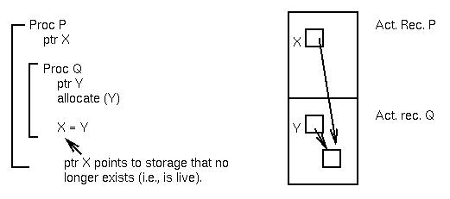
Stacks and dynamic allocations are incompatible
Why can’t we just do dynamic allocation within the stack?
Programming Language design and Implementation -4th Edition
Copyright©Prentice Hall, 2000

Slide 6
How does things become garbage?
int *p, *q;
…
p = malloc(sizeof(int));
p = q;
Newly created space becomes garbage
  for(int i=0;i<10000;i++){
  SomeClass obj= new SomeClass(i);
  System.out.println(obj);
  }
Creates 10000 objects, which becomes garbage just after the print

Slide 7
Where to put the heap?
SB
Stack memory area
ST
Stack grows downward
Heap can expand upward
HT
Heap memory area
HB

Slide 8
How to keep track of free memory?
Stack is LIFO allocation => ST moves up/down everything above ST is in use/allocated. Below is free memory. This is easy! But …
Heap is not LIFO, how to manage free space in the “middle” of the heap?
SB
Free
HT
Allocated
Mixed:
Allocated
and
Free
reuse?
ST
Free
HB

Slide 9
How to keep track of free memory?
How to manage free space in the “middle” of the heap?
=> keep track of free blocks in a data structure: the “free list”. For example we could use a linked list pointing to free blocks.
freelist
A freelist!
Good idea!
But where do we find the memory to store this data structure?
HT
Free Next
Free Next
Free Next
HB

Slide 10
Types of garbage collectors
The “Classic” algorithms
  Reference counting
  Mark and sweep
Copying garbage collection
Generational garbage collection

Slide 11
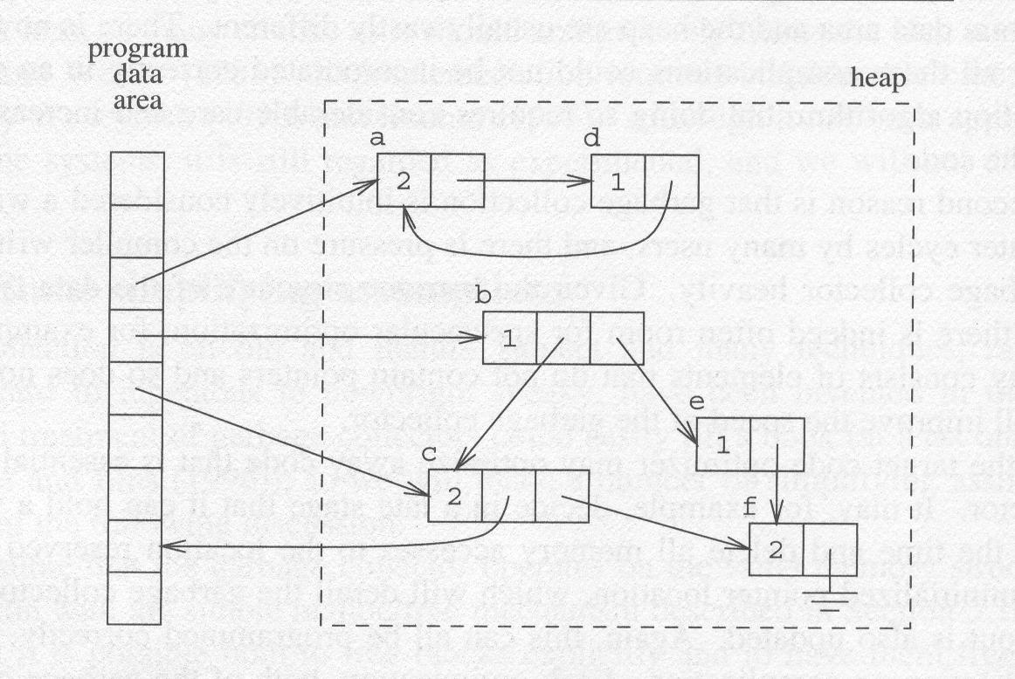
Reference Counting

Slide 12
Mark-Sweep
The first tracing garbage collection algorithm
Garbage cells are allowed to build up until heap space is exhausted (i.e. a user program requests a memory allocation, but there is insufficient free space on the heap to satisfy the request.)
At this point, the mark-sweep algorithm is invoked, and garbage cells are returned to the free list.
Performed in two phases:
  Mark: identifies all live cells by setting a mark bit. Live cells are cells reachable from a root.
  Sweep: returns garbage cells to the free list.
  Compaction: we push live cells to one end of the heap
    We can add a compaction phase as shown in Fig. 12.17.

Slide 13
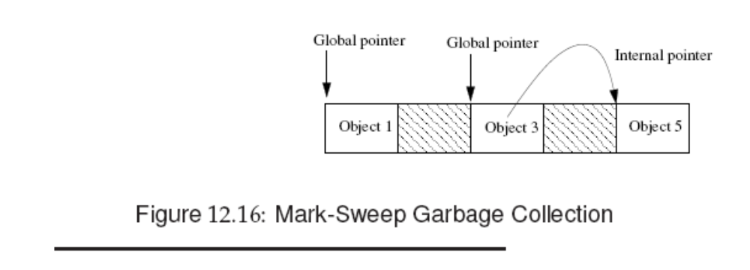
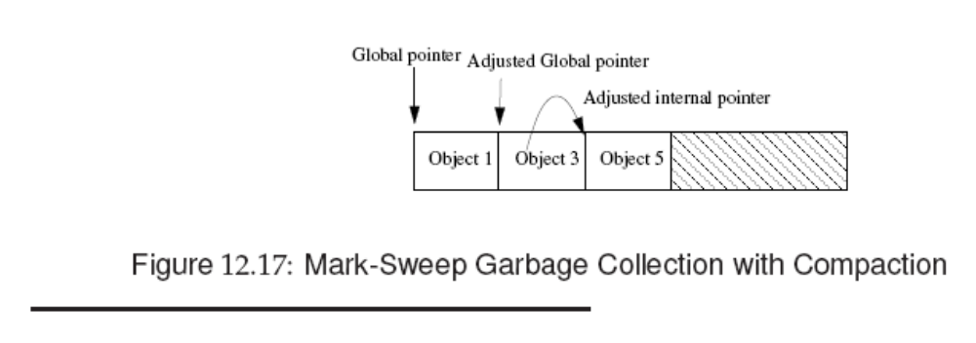

Slide 14
Copying Garbage Collection
Like mark-compact, copying garbage collection does not really "collect" garbage.
Rather it moves all the live objects into one area and the rest of the heap is known to be available.
Copying collectors integrate the traversal and the copying process, so that objects need only be traversed once.
The work needed is proportional to the amount of live data (all of which must be copied).

Slide 15
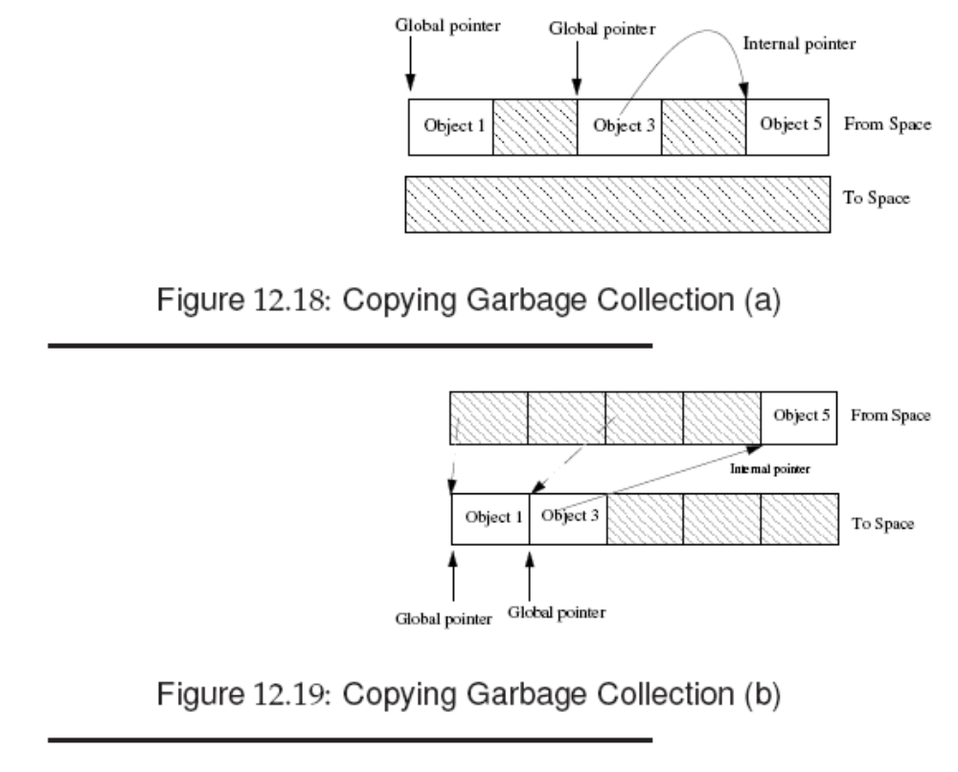
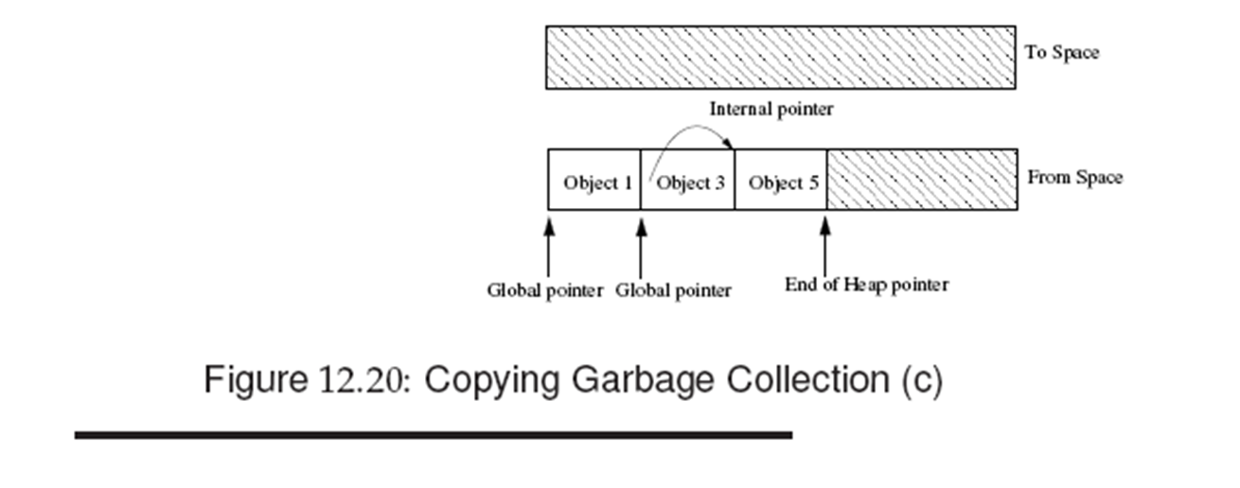

Slide 16
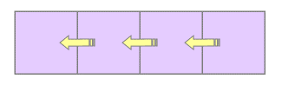
Generational Garbage Collection
Attempts to address weaknesses of simple tracing collectors such as mark-sweep and copying collectors:
  All active data must be marked or copied.
  For copying collectors, each page of the heap is touched every two collection cycles, even though the user program is only using half the heap, leading to poor cache behavior and page faults.
  Long-lived objects are handled inefficiently.
Generational garbage collection is based on the generational hypothesis:
Most objects die young.
As such, concentrate garbage collection efforts on objects likely to be garbage: young objects.

